Slide 1
CSC 519 – DevOps Pipeline
Arun Jaganathan- ajagana
Balasubramanian Ramesh Babu- bramesh
Krithika Sekhar- ksekhar
Vivek Mani- vmani2

Slide 2
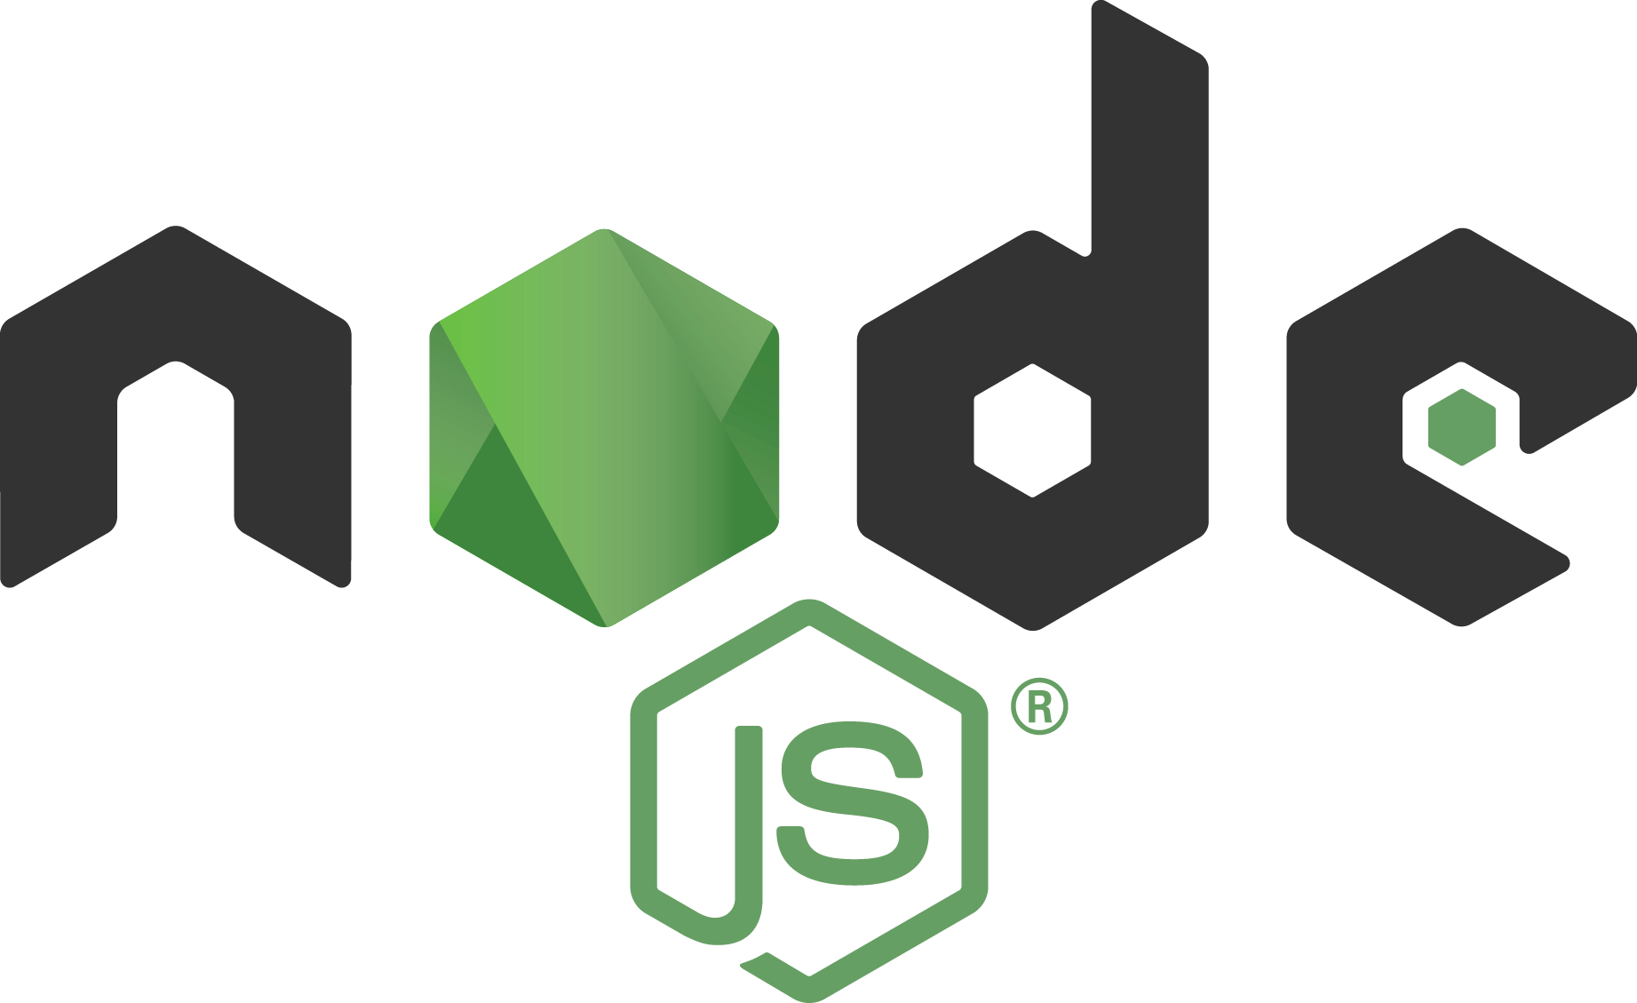

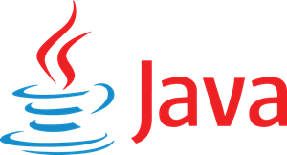









Applications under study
iTrust2 – Hospital management system | Checkbox.io – Survey hosting application

Slide 3

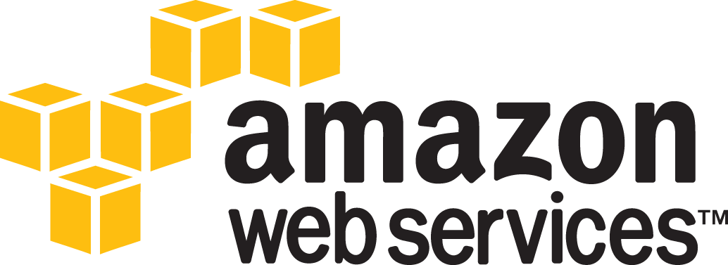





Tools Used

Slide 4
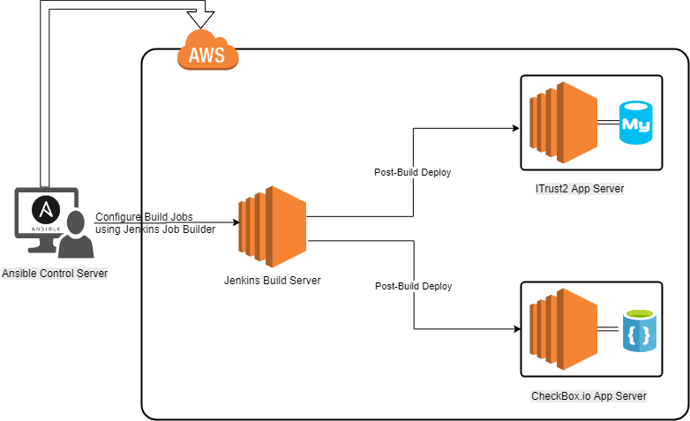
M1 : Configuration Management + Build Milestone
Create Remote VMs in AWS
Configure Jenkins build server
Configure Jenkins build jobs to deploy iTrust2 and checkbox.io

Slide 5
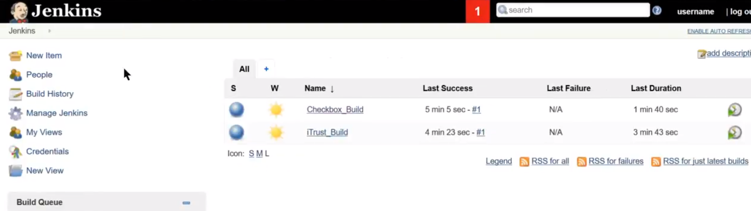
Milestone #1 Extracts

Slide 6
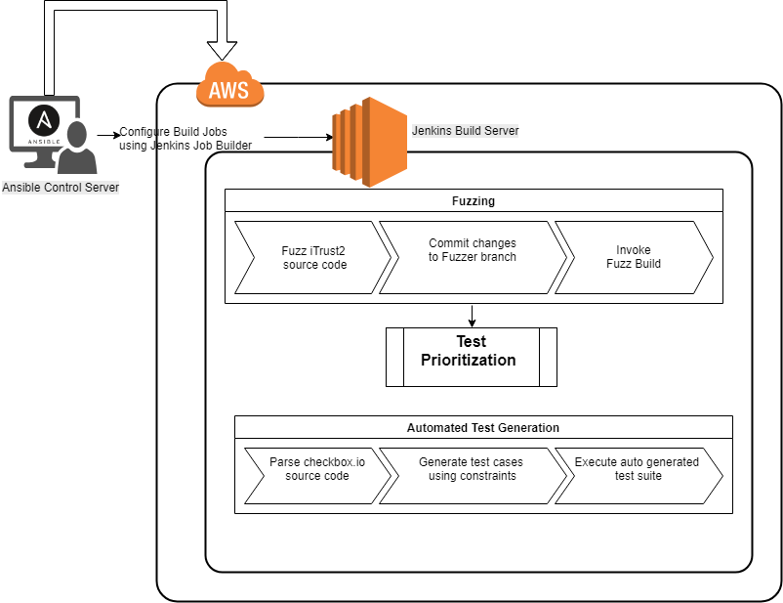
M2 : Test + Analysis Milestone
Fuzz iTrust2 source code, test it and prioritize the test cases using the results
Parse checkbox.io code and generate testcases automatically
Publish test coverage report to Jenkins dashboard

Slide 7
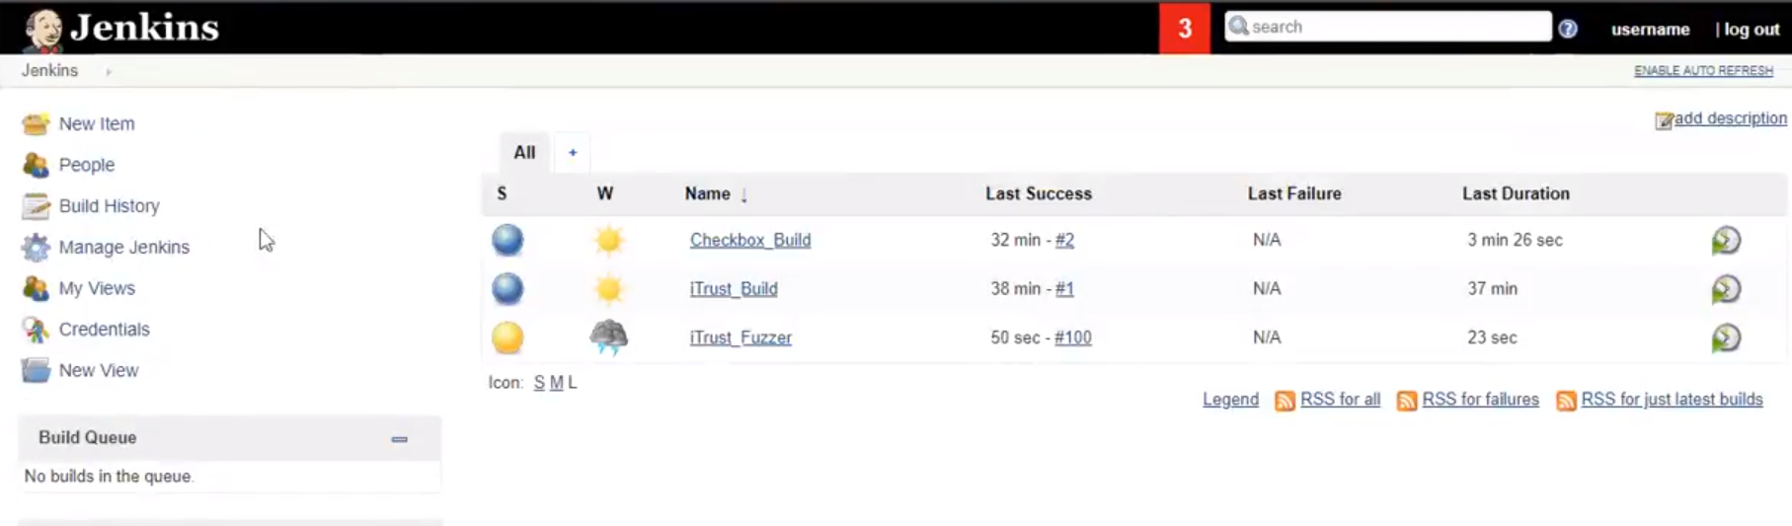
Milestone #2 Extracts

Slide 8
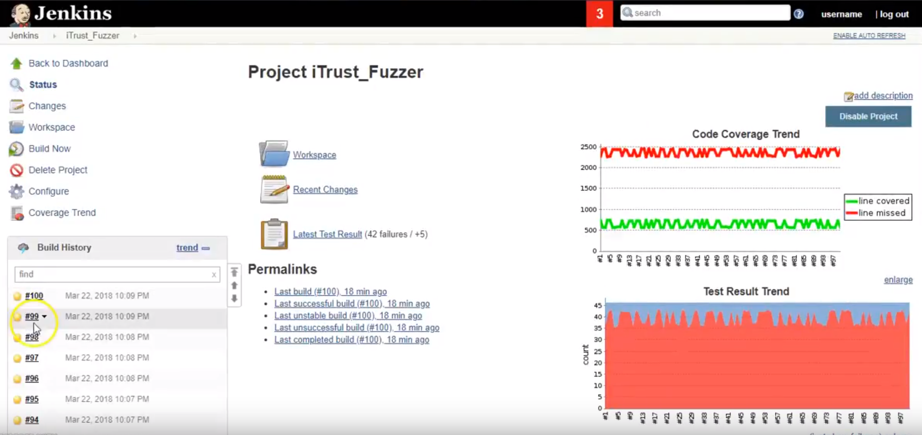
Milestone #2 Extracts

Slide 9
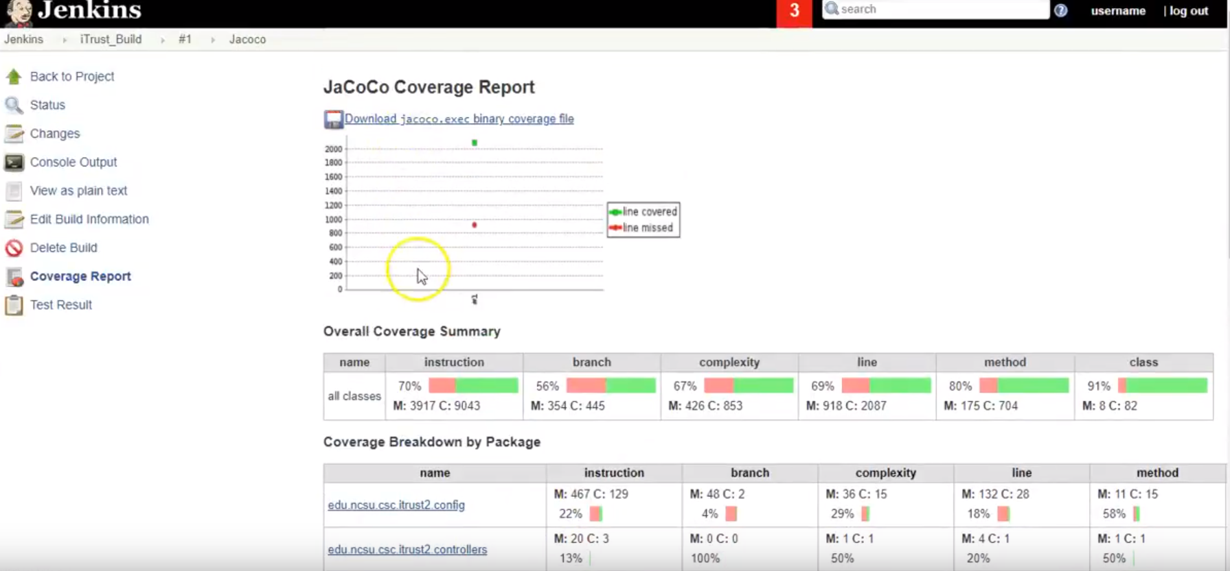
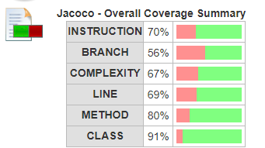
Milestone #2 Extracts

Slide 10
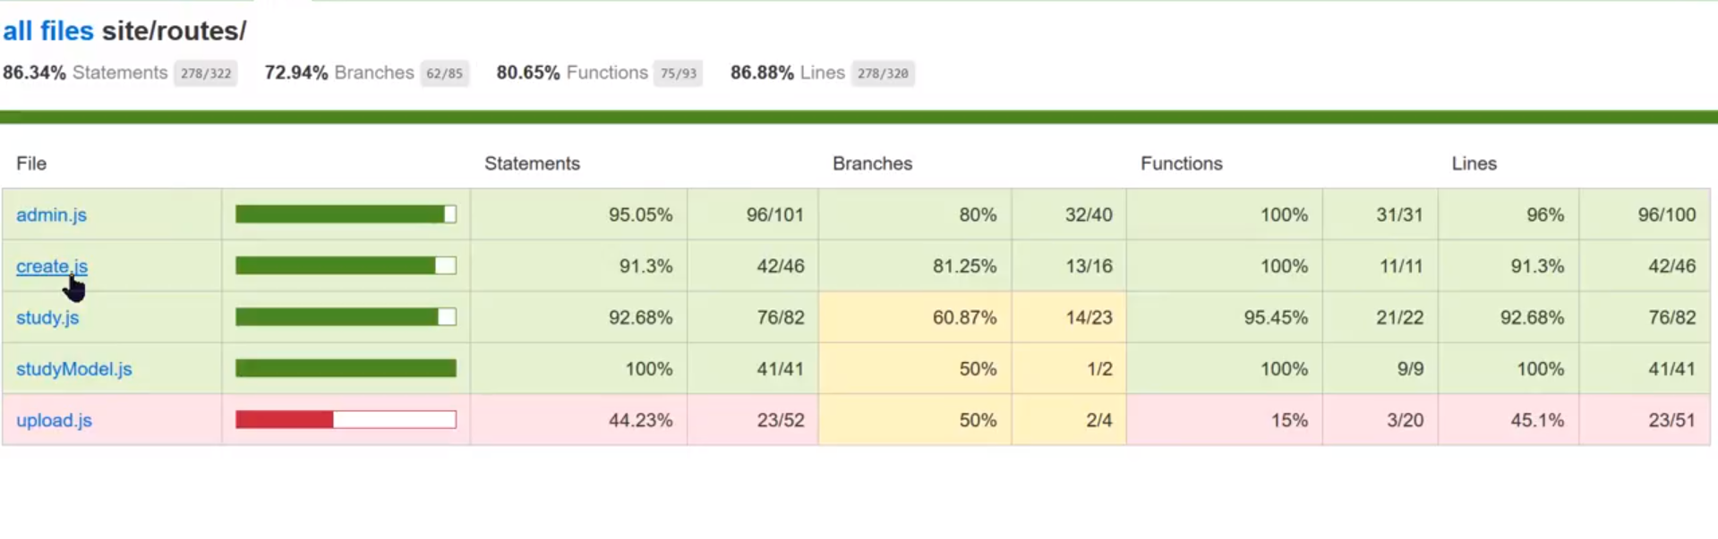
Milestone #2 Extracts

Slide 11
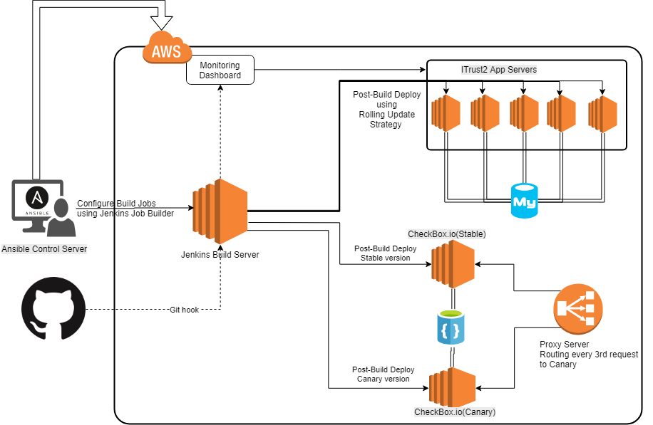
M3 : Deployment Milestone
Create Git hooks to trigger Jenkins build upon commit to production.
Implement Rolling update deployment strategy for iTrust2 and monitor the same using a dashboard
Perform Canary releasing for checkbox.io, routing every 3rd request to Canary server

Slide 12
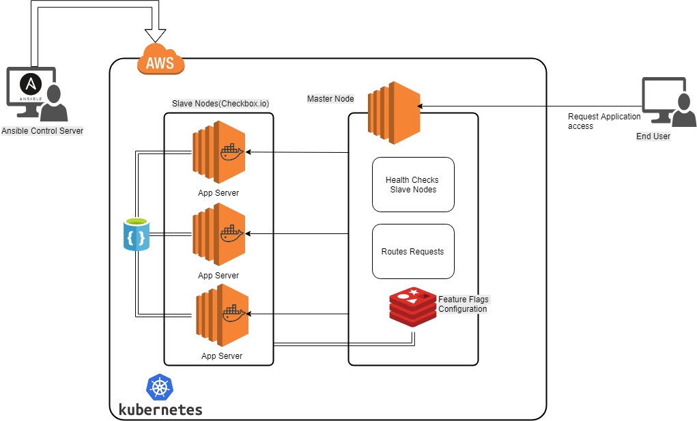
M3 : Deployment Milestone (Contd.)
Created a Kubernetes cluster for checkbox.io, providing high availability.
Implemented feature flags using in-memory Redis database

Slide 13
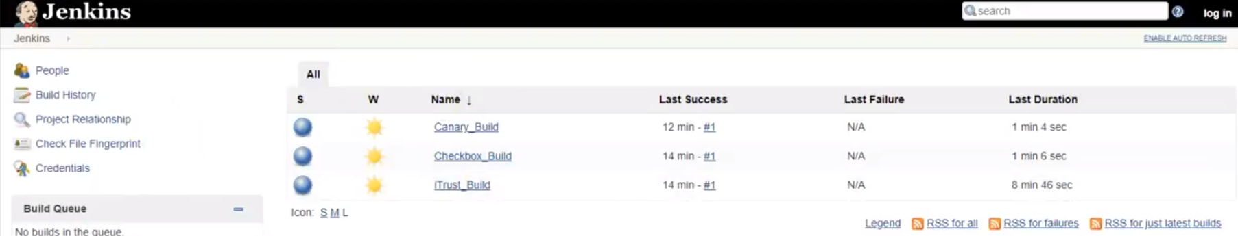
Milestone #3 Extracts

Slide 14
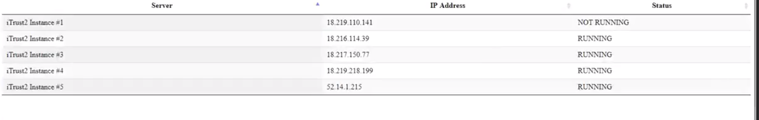
Milestone #3 Extracts

Slide 15
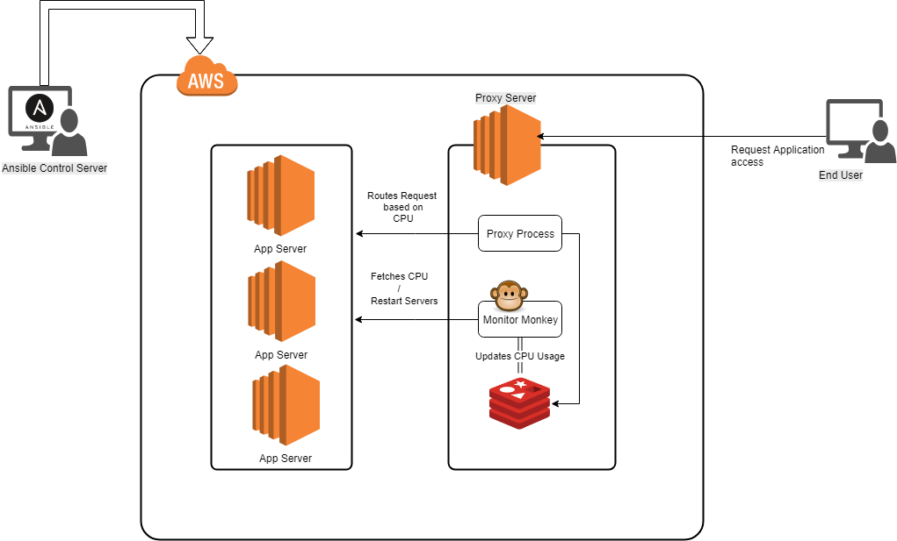
M4 : Special Milestone
Implement Monitor Monkey
Monitors the CPU usage for all servers.
Restarts servers that have high CPU usage over a period of time.
Updates Redis store with the CPU usage for all servers
Use a proxy server to route incoming requests to servers with high CPU availability.

Slide 16
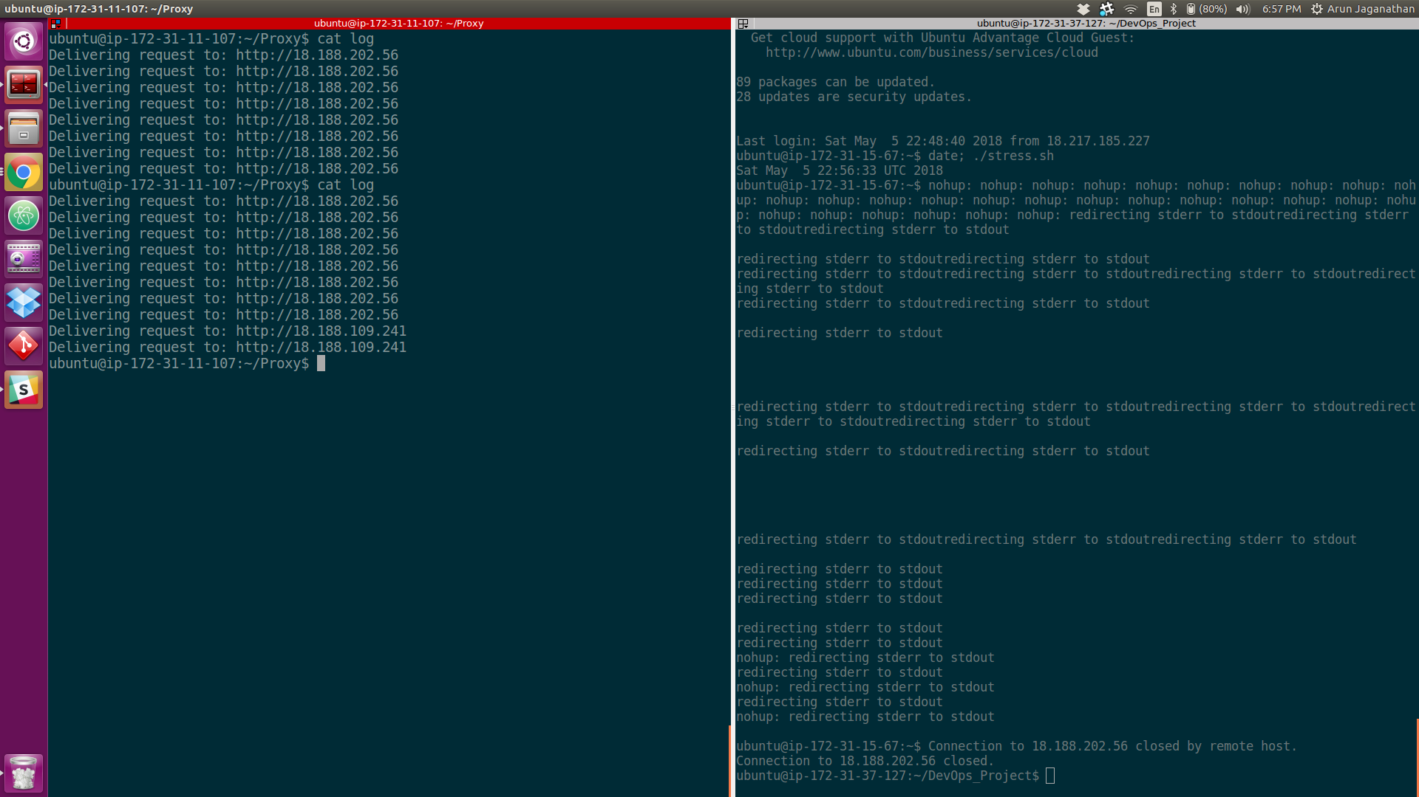
Milestone #4 Extracts

Slide 17
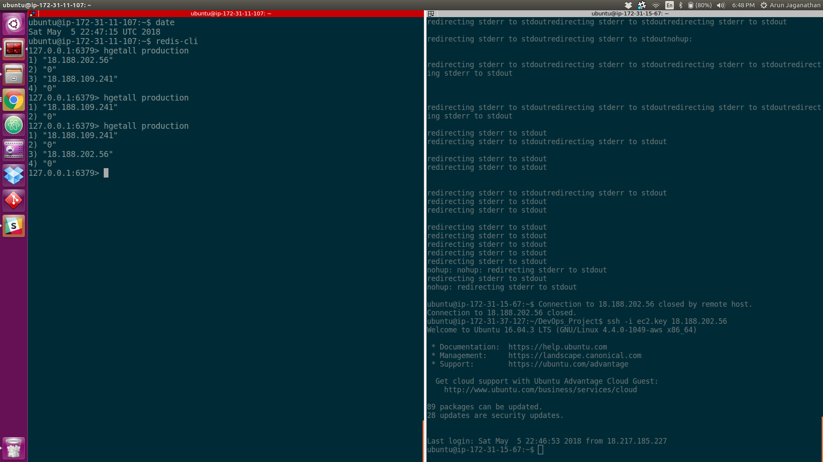
Milestone #4 Extracts

Slide 18
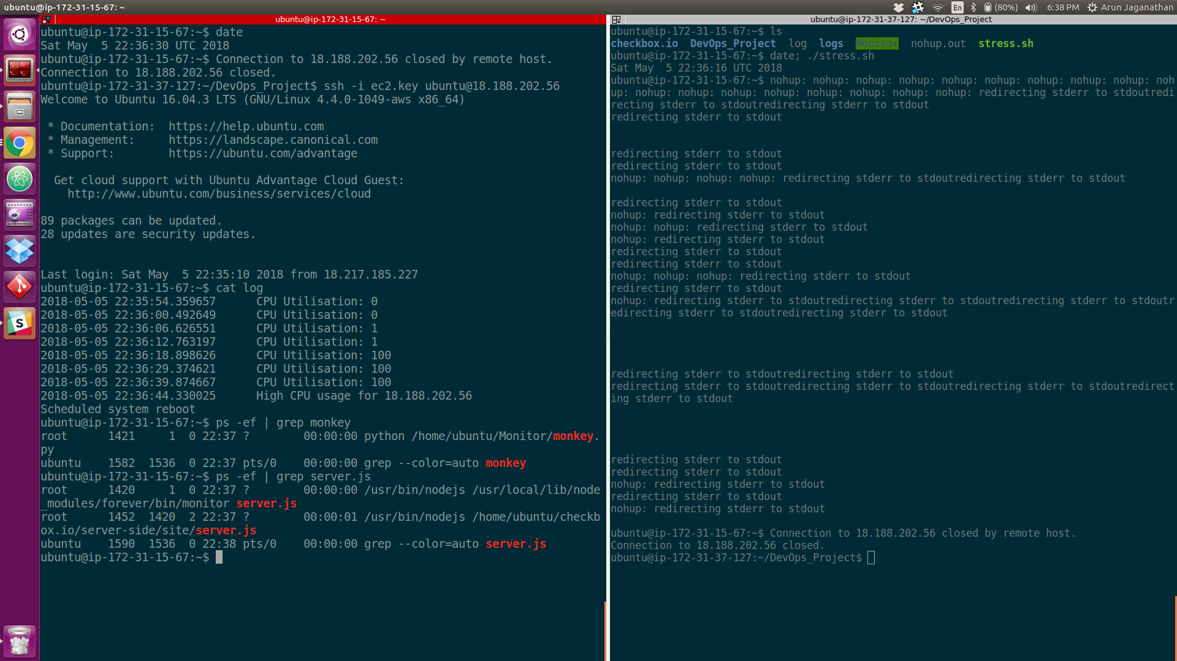
Milestone #4 Extracts

